Slide 1
SMOG ALERT

Slide 2
Table of contents
AIR QUALITY IN THE WORLD
AIR QUALITY IN THE US
SMOG IN EUROPEAN COUNTRIES
AIR QUALITY IN FRANCE
SMOG IN POLAND
WHAT IS DONE LOCALLY ?
After pressing the arrow you will go to the topik chosen by you.

Slide 3
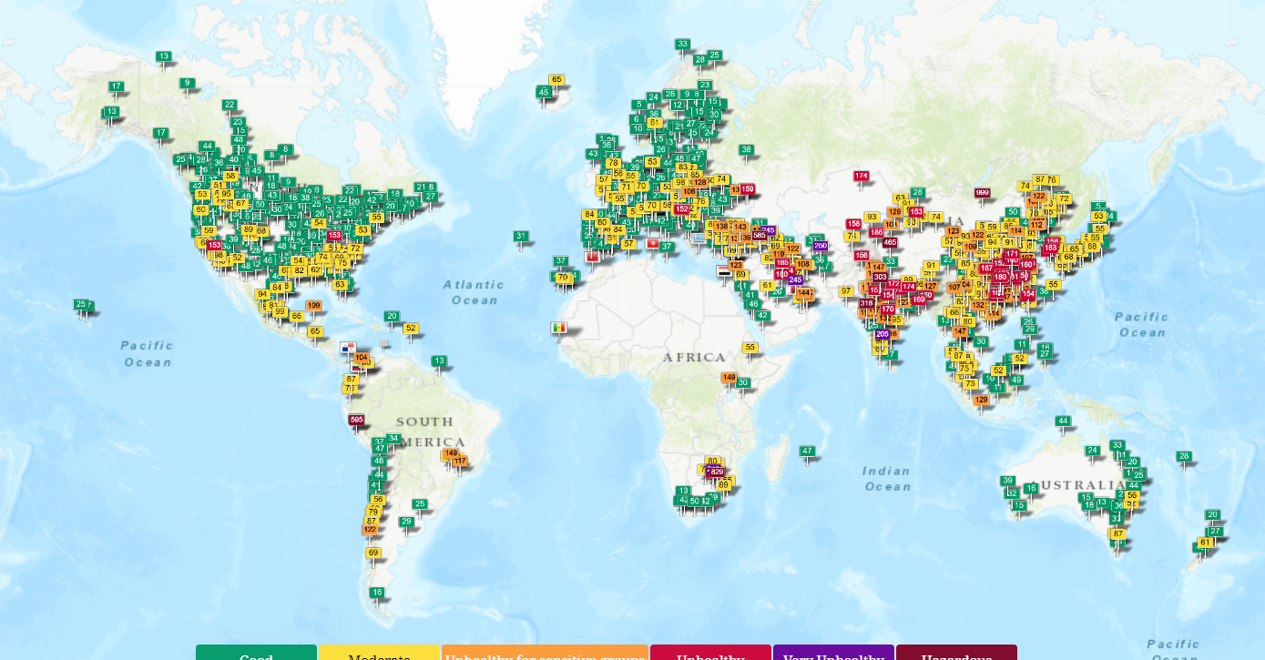
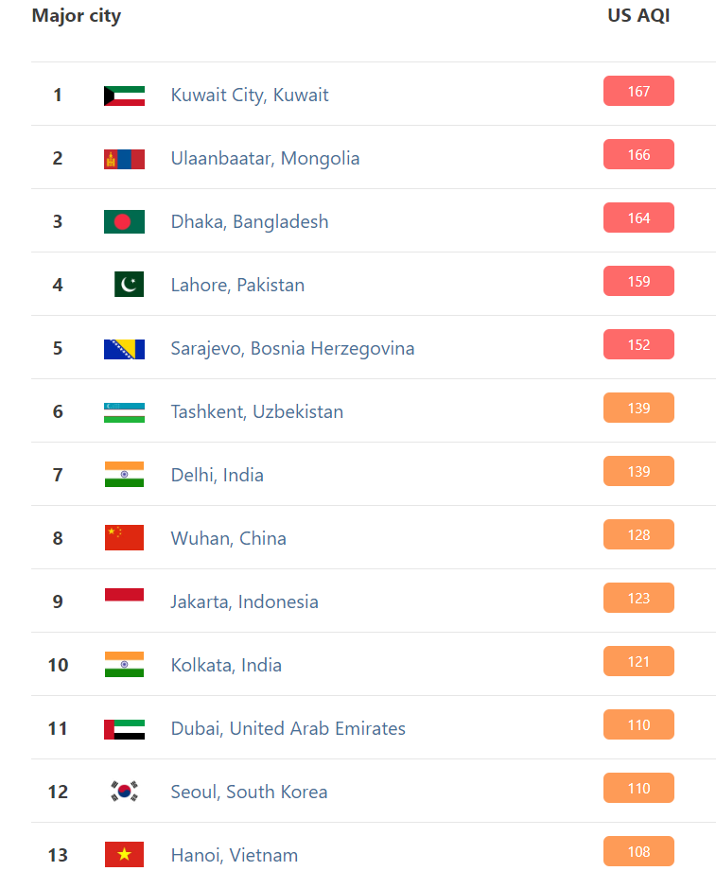
Air quality in the world
The most polluted cities are in Asia. There air pollution idicators indicate levels that endanger the health many people. There are also many cities in the world where air pollution indicates even 600, 800 and 900 AQI ( hazardous level). In Europe and both Americas air remains at good or moderate level which is safer for human health.

Slide 4
AIR QUALITY IN THE US
Although more and more cars are moving on US street, NASA announcements show that air quality is steadily improving. Scientists publish maps of nitrogen dioxide concentration, from which it is quite clear that actions in the political and legal field are bringing the expected results. Date on air quality in the US is provided by th Aura satellite, which measures for example ozone levels in the atmosphere. Analysis of the date allowed scientists to conclude that Americans inhale much less toxic nitrogen dioxide which is harmful to the human body. The state of air quality is an issue that is so important that it is regulated by law un many countries. The European Union has had its guidelines for about 30 years, but the United States has its standards even longer. The WHO ( World Health Organization) sets the most stringent and restrictive thresholds – the latter, although most favorable for citizens do not have legal force. The Clean Power Plan is a policy designed by the Obama Administration to lower the levels of carbon dioxide emitted by power plants in the United States. The major estimated positive externalities of the plan include the reduction of air pollutants by up to 25% and the elimination of serious health altercations for those who live near factories and chemical facilities that emit carbon dioxide such as a considerable decrease of premature deaths and asthma attacks among children. The Environmental Protection Agency has been aythorized to regulate pollution from stationary sources ( such as power plants, chemicals plants and gas stations) and mobile sources (such as cars, trucks and airplanes). It also set exposure limits for particulate matter and five other air pollutants dangerous to human health which E.P.A is required to regularly review and update the latest scientific achievements.

Slide 5
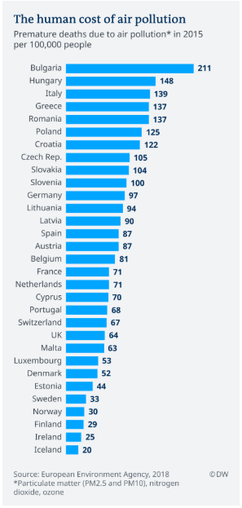
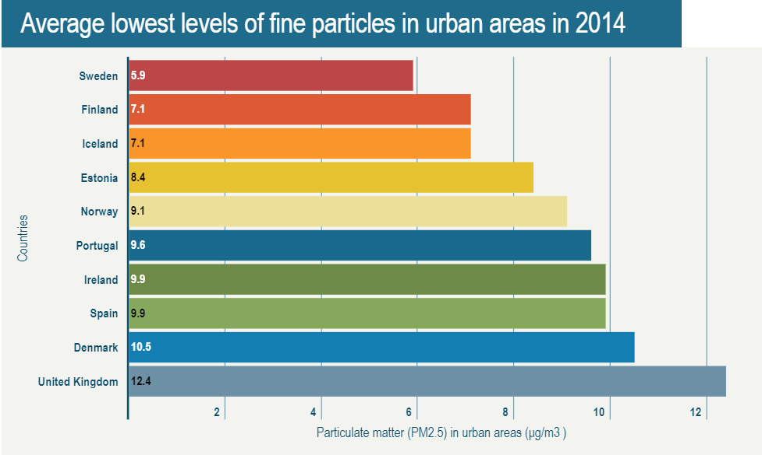
Smog in europeAN countries
According to the new WHO statistics, Bosnia and Herzegovina, Bulgaria, Albania and the Ukraine have the highest European mortality rates attributed to home and air pollution. Many of these same countries, including the Former Yugoslav Republic of Macedonia, Poland and Hungary have the highest average annual levels of city air pollution. The cleanest air in Europe have Sweden, Iceland, Finland, Estonia and Norway. Most premature deaths due to smog in Europe have been reported in Bulgia, Hungary, Italy, Grecee and Romania.

Slide 6
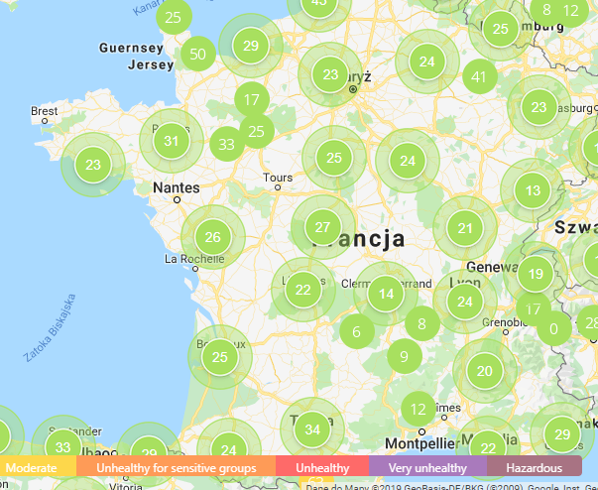
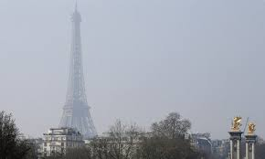
Air quality in the france
France has good air quality. In Paris, a smog alarm is announced as soon as PM10 air pollution exceeds the daily level of 80 μg / m3. For example in Poland a smog alarm is only announced after exceeding 300 μg / m3. Like many European cities, the Paris region has a well-established system of emergency actions that escalate if smog persists. Initial steps include health warnings, reduced speed limits and restrictions on lorries in the city centre. Final steps include cheaper public transport (€3.80 for a day pass), and bans on half of cars, using an odd/even number plate system. This time, instead of taking half of the cars from the roads, Paris banned the oldest diesels. This was made possible by a new French scheme to label cars according to the pollution that they emit. Electric ones get a green sticker. A petrol car made between 1997 and 2003 gets an orange sticker. The new smog scheme banned the most polluting diesels, those more than 16 years old.
5 the most polluted cities in France:
Saint-Denis (Seine-Saint-Denis), 17,6 μg/m3
2. Saint-Mandé (Val-de-Marne) 16,2 μg/m3
3. Paris 15,6 μg/m3
4. Valenciennes (Nord) 15,3 μg/m3
5. Douai (Nord) 15 μg/m3

Slide 7
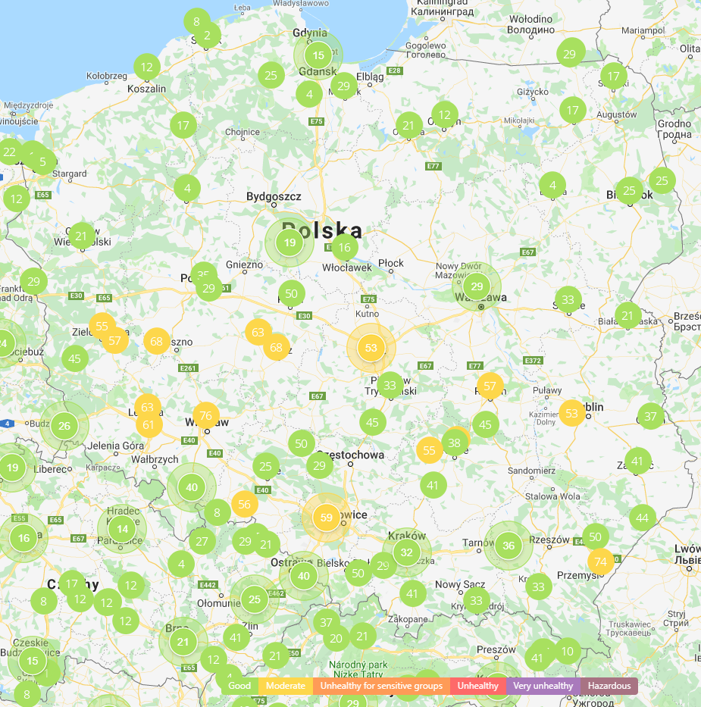
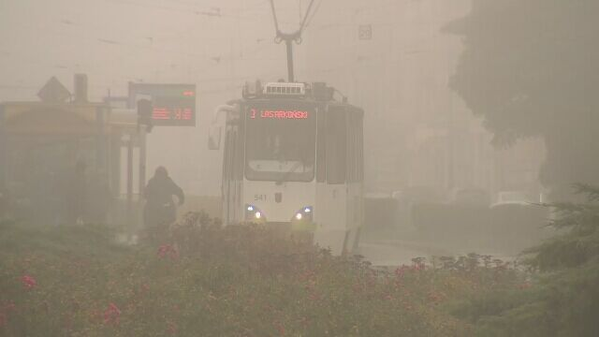
SMOG IN POLAND
In Poland, air quality in most cities is good but there are still cities where the air remains at a moderate level. In Poland a smog alarm is only announced after exceeding 300 μg / m3. During a smog alarm children, seniors and pregnant women must be informed of poor air quality and an order to stay at home. Out of the 50 most polluted cities in Europe as many as 36 are in Poland. Place 3-6 are taken by Opoczno, Żywiec, Rybnik and Pszczyna while places 8-10 Karków, Nowa Ruda and Nowy Sącz. Bulgaria holds the remaining top ten positions. Only recently in our country has it become louder and Polish people began to invest in anti-smog masks and control air quality using the application.

Slide 8
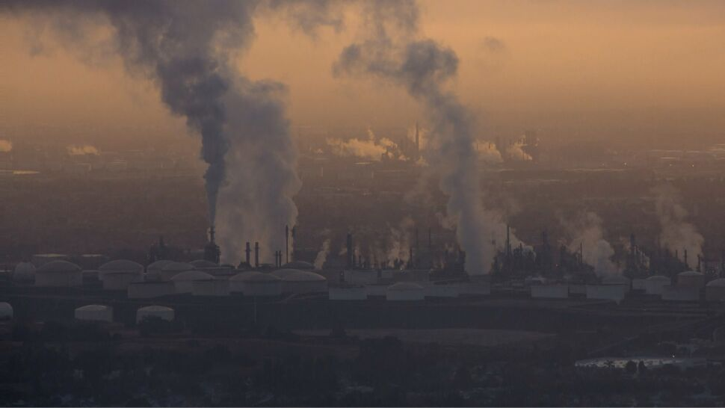
In Poland, the Clean Air program is the main instrument in the fight against smog, which every year kills over 40 thousand people. The main objectives of program are to improve the Energy efficiency of single-family houses and reduce dust emissions to the atmosphere. It will be achieved through thermomodernization of houses and replacement of furnaces. In order to help residents in furnace replacement, the European Union organized a subsidy program.To improve the quality of the air in the country the Polish government decided to introduce punishments for rubbish smokers in furnaces. As part the Clean Air project in cities are organised lectures about smog and how to prevent it. An example of a city that actively works against smog is Krakow. From September 1 2019, in Krakow was introduced a ban on burning coal and wood in furnaces. In the city were also introduced higher prices for parking cars in the city center.

Slide 9
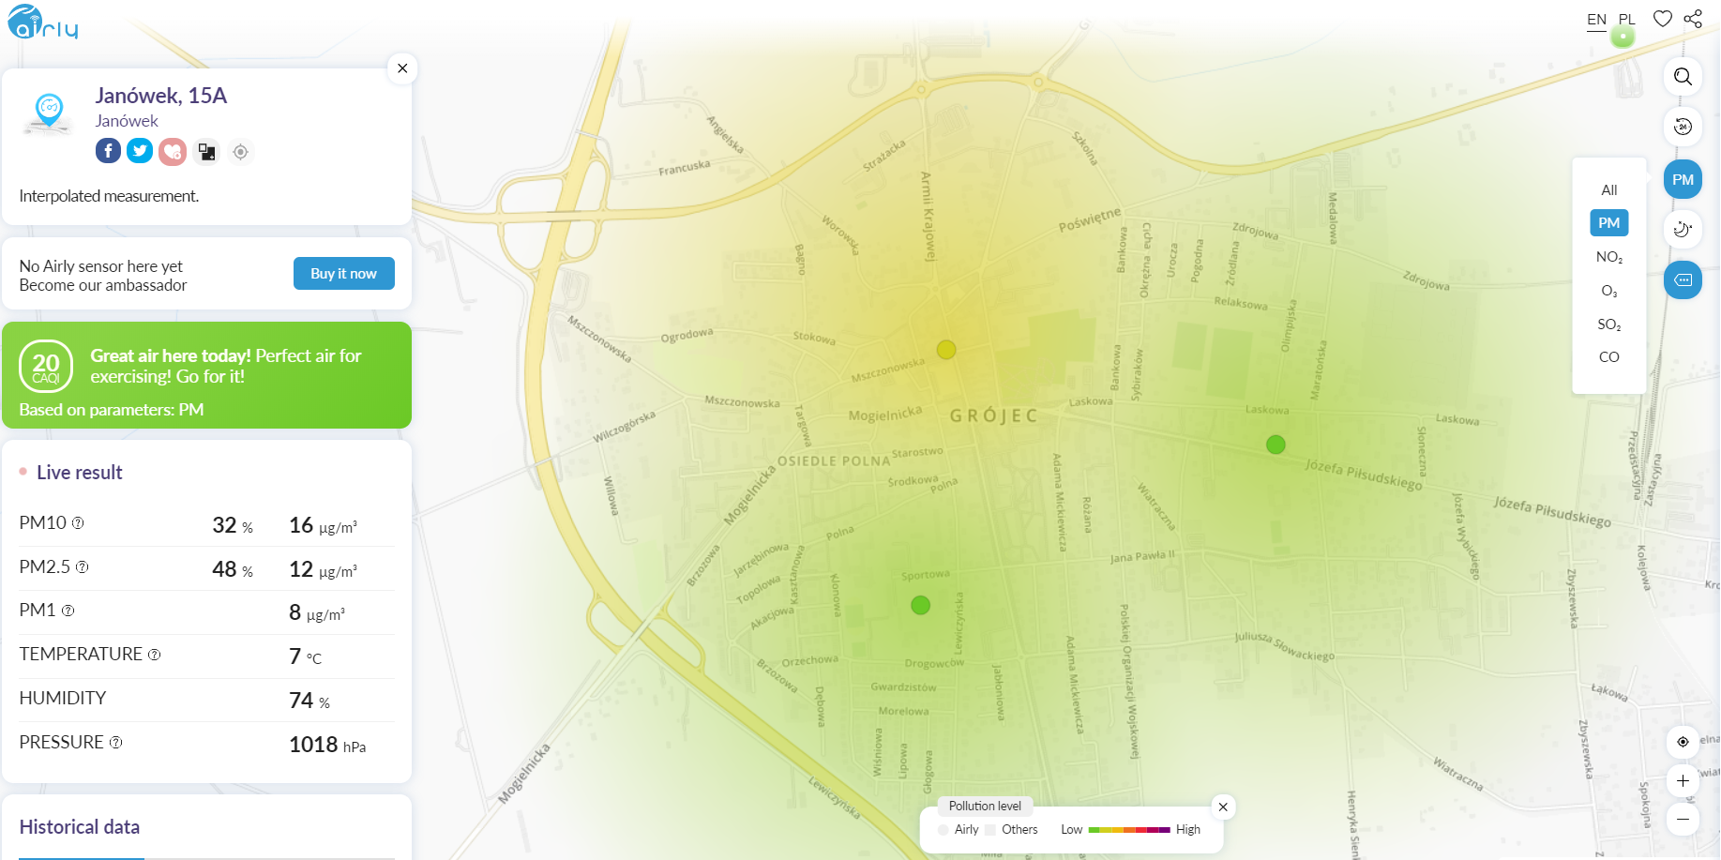
What is done locally ?
Grójec boasts very good air quality. The city government are really involved in the fight against smog in Grójec. In order to encourage residents to replace cars with bicycles, the mayor of the city commutes by bicycle. In the schools in the Grójec commune were conducted lessons educating children about smog. An example of such school is the primary school in Częstoniew. The city also conducted a lecture on smog implemented from the Clean Air project. In the autumn and winter period, the city guard conducts inspections related to what residents of single-family houses burn in furnaces.

