Slide 1
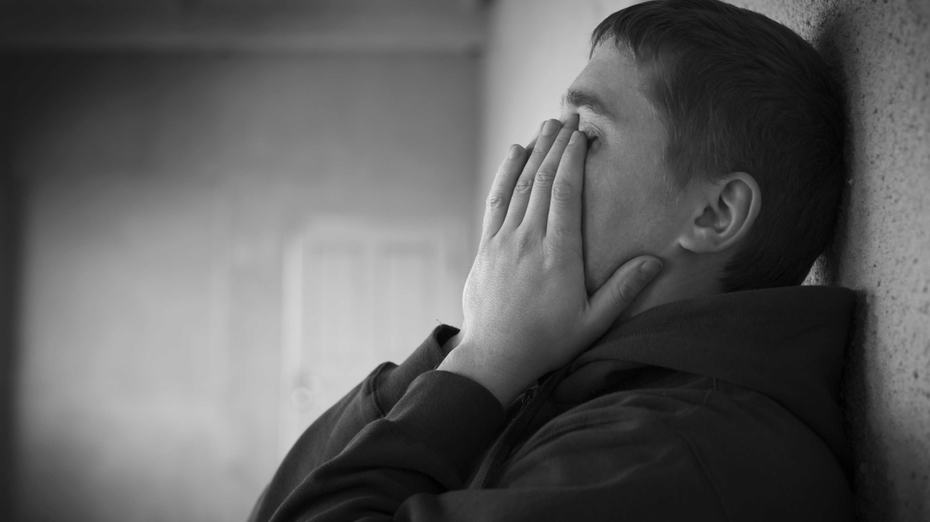
Depression among young people - how to deal with it?

Slide 2
What policy are Polish schools pursuing to deal with depression among young people?
Various institutions are being created to offer help to teenagers with depression.
Psychologists find in schools who also offer help and support.
There are numerous anti-depressant phones where we can talk about our problems.
The subject of depression is not neglected and raised by teachers.
There are numerous campaigns, advertising spots reminding that we are not alone and we can always count on the help of third parties people.

Slide 3
Useful anti-depressant phones, helplines in Poland.
+48 22 654 40 41 - "Itaka" Foundation, which runs an Antidepressant Helpline and provides extensive support to people suffering from depression and their loved ones.
+48 800 70 2222 - Support Center for people in a state of mental crisis, a free phone line is available 24 hours a day, 7 days a week for people in a mental crisis who need immediate psychological help.
116 111 - "The Giving Children Strength" Foundation offers free telephone and online support for children and teenagers, as well as for parents and teachers by operating the Helpline for Children and Youth.

Slide 4
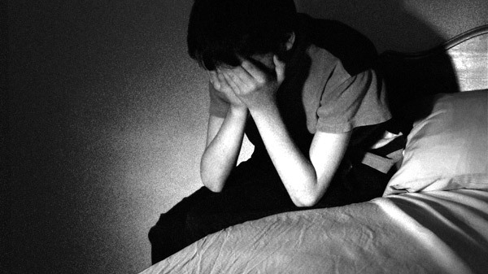
According to statistics, in 2018 in Poland, 746 teenagers aged 13-18 years and 1143 people aged 19-24 tried to commit suicide.

Slide 5
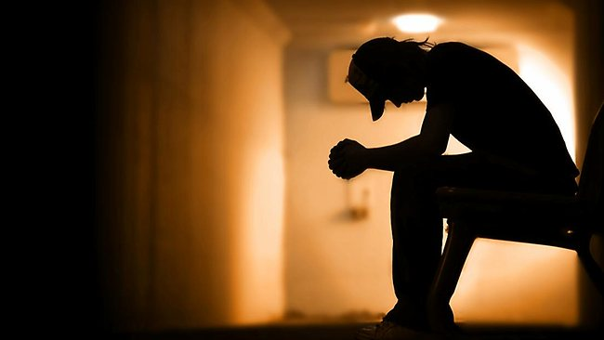
Let's not be indifferent, let's start reacting.

Slide 6
What actions does our school take to combat youth depression problems?
Our school cooperates with the psychological and pedagogical outpatient clinic in Grójec.
Our school has prevention and helps a psychologist and school educator.
Lectures and conversations with local police are also often organized about problems with depression in our environment.
We always have the opportunity to come to the teacher and tell about their problems, they will try to help us as much as possible.

Slide 7
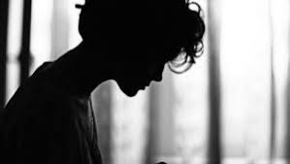
let's take care of problems among young people

Slide 8
presentations were prepared by Natalia Tadzik, a high school student in Grójec

