Slide 1
INTERNET
ADDICTION

Slide 2
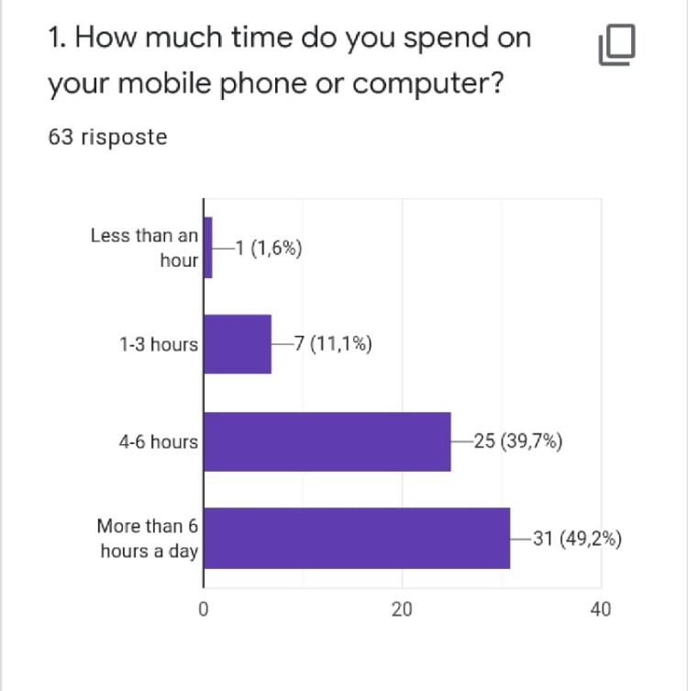
The survey shows 49.2% of young people spend more than 6 hours on their mobile phone or computer, while only 1.6% spend less than an hour. Remember that due to this pandemic period and the fact we are forced to stay indoors, it is obvious either for work or for study we can spend more on the mobile phone or computer than expected.

Slide 3
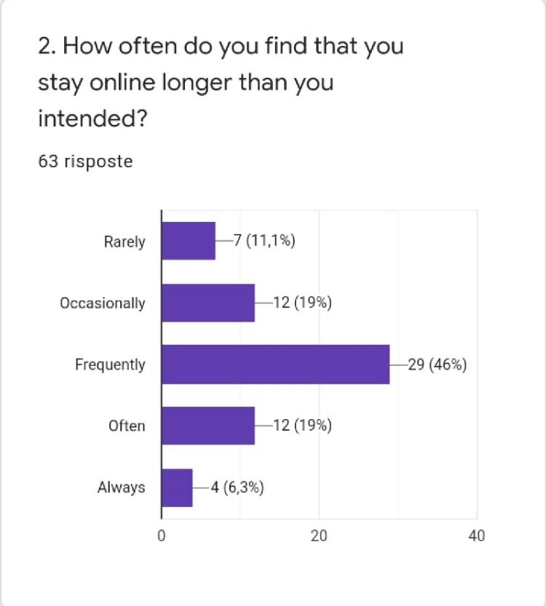
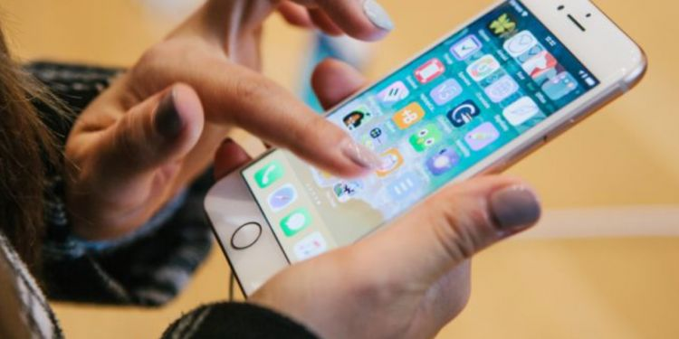
Here you can see the majority of respondents spend much more time than scheduled on the Internet (46%). Only 11.7% rarely does as planned, 19% occasionally. Otherwise, the data show that 6.3% of respondents pay no attention to time.

Slide 4
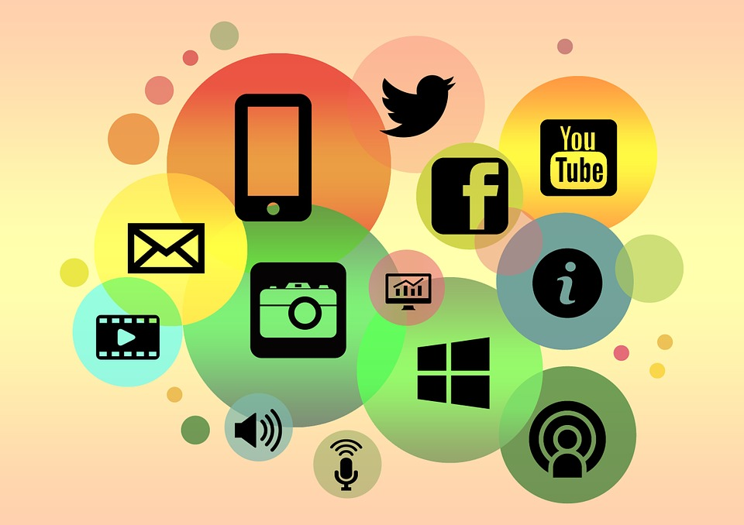
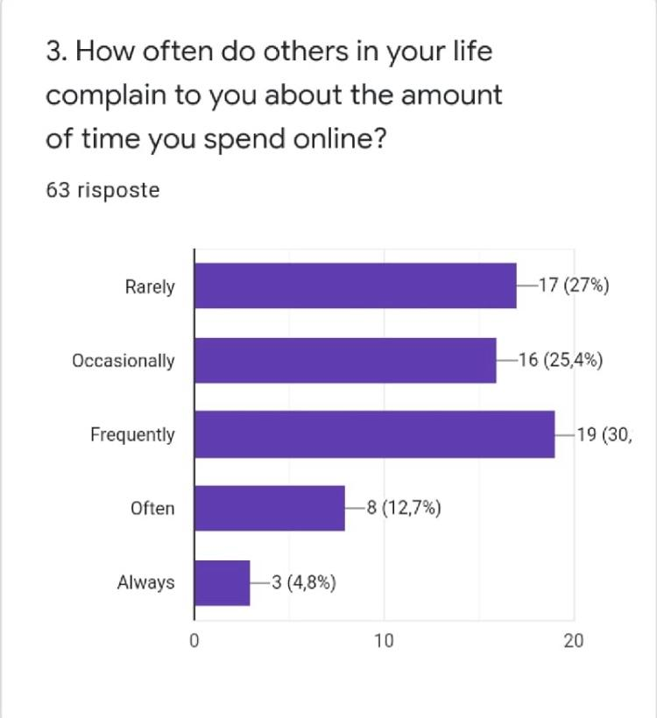
The majority of respondents (30%) often complain about the time we spend online, but only 4.8% always complain, while 27% rarely moan.

Slide 5
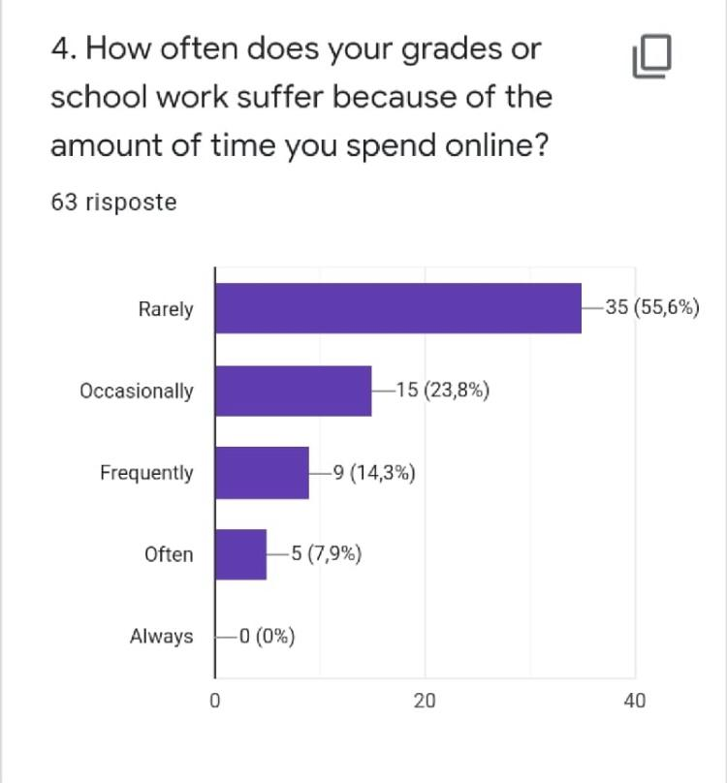
As we can see from the survey, none of the respondents' grades always suffer because of the amount of time they spent online, however 35 of them rarely have this trouble, 15 participants occasionally have it and only 5 of them often suffer of it.

Slide 6
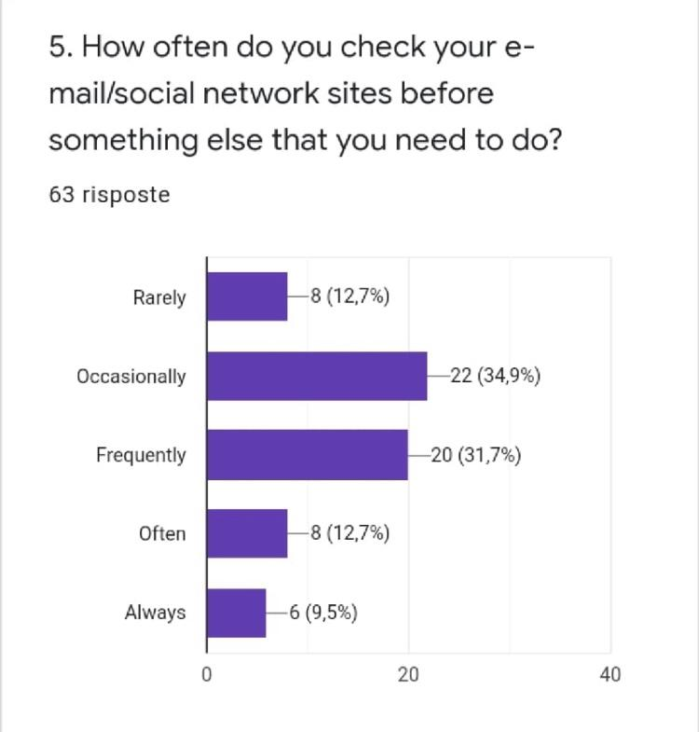
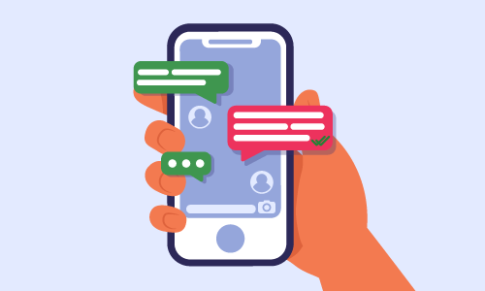
The graph shows us how often we check emails and social networks before something else we need to do.
the majority occasionally check them (34,9%) or frequently (31,7%), the minority (9,5%) always controls them.
Only the 12,7% rarely control them.
Luckily there are few who always consult emails or social media before doing something else, but unfortunately there are still too few teenagers who rarely control them.

Slide 7
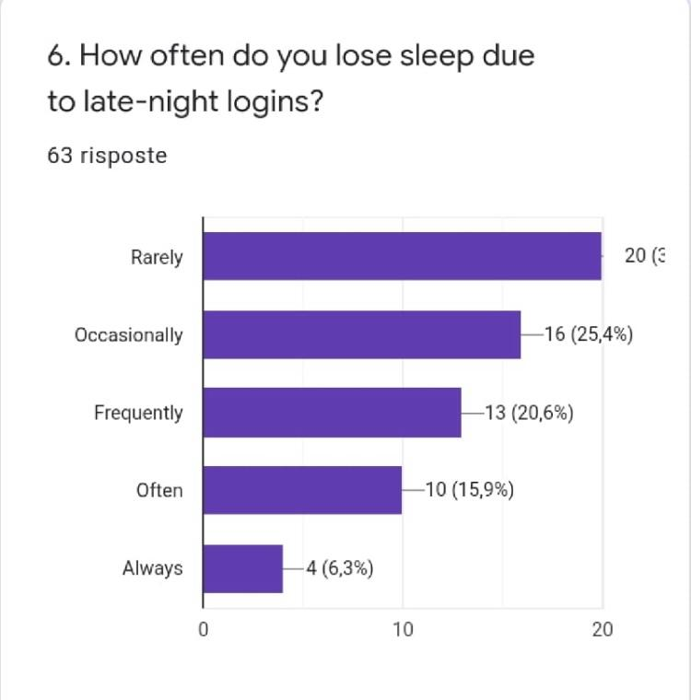
As you can see from these results only 6.3% of young people always lose sleep due to late-night logins but, unfortunately, moreover 15.9% and 20.6% of them often and frequently lose sleep due to late-night logins.
Luckily for the majority of young people, 31.8%, this happens rarely. The same for 25.4% of them, who occasionally let it occurs.

Slide 8
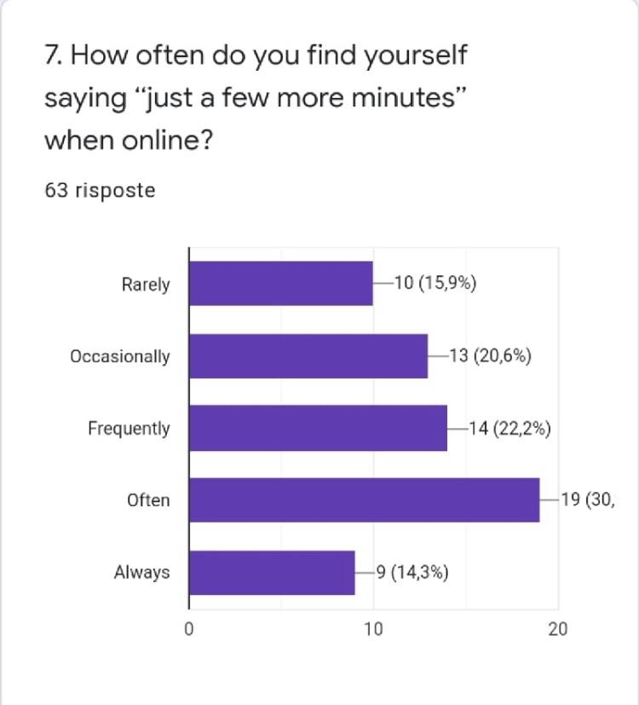
Here the graph shows percentages of how often guys in our school find themselves saying “just a few more minutes” when online. A lot of them answered “often”, while the minority answered “always”. However it’s important to note percentages of other responses are also very high, and this means that it is a fairly frequent event.
From these results we might ask why people have trouble turning off their phones and focusing on other. Maybe because they are bored or because they don’t receive stimulation in doing other things. We should also consider that we are in a very particular historical period, in which it’s very difficult to be encouraged.

Slide 9
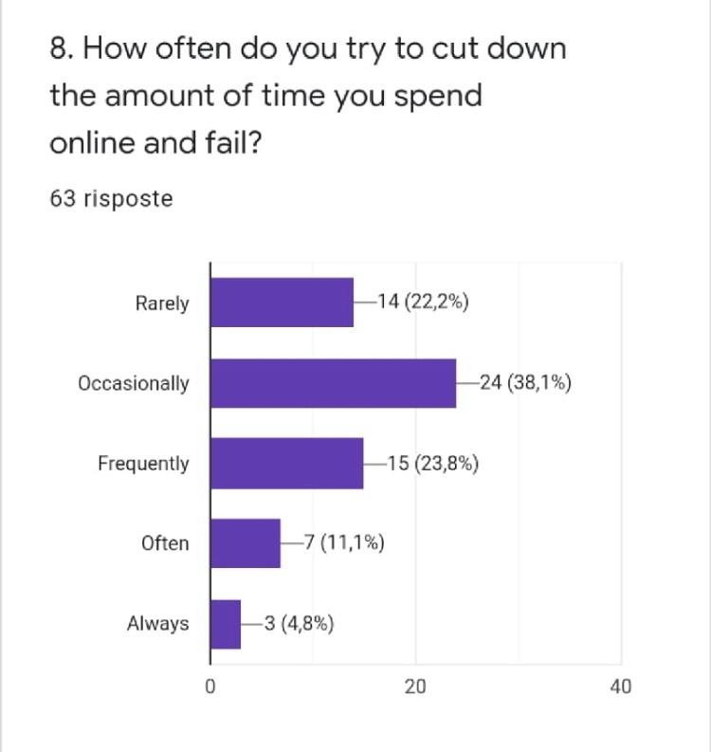
Responses indicate occasionally fail while trying to cut the amount of time they spent online and only the 4,8% fail anytime. Instead, the 22,2% fail rarely and the 23,8% cut out occasionally. Only the 7,8% break down often. So, we can say a big part of people can almost always control they "abuse" of the internet.

Slide 10
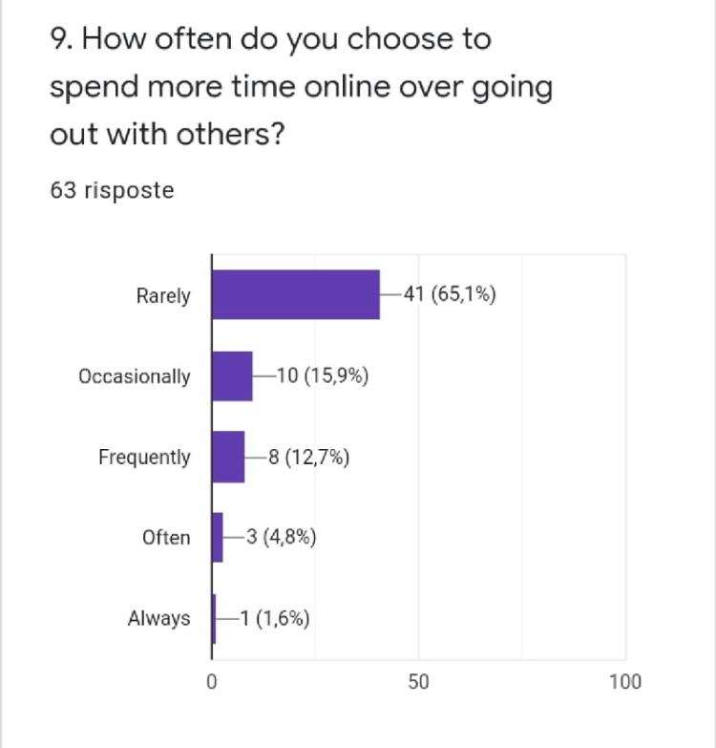
Here it is interesting to see 65,1% of young people rarely spend more time online over going out with others and only 1,6 % prefers to always spend time online.

Slide 11
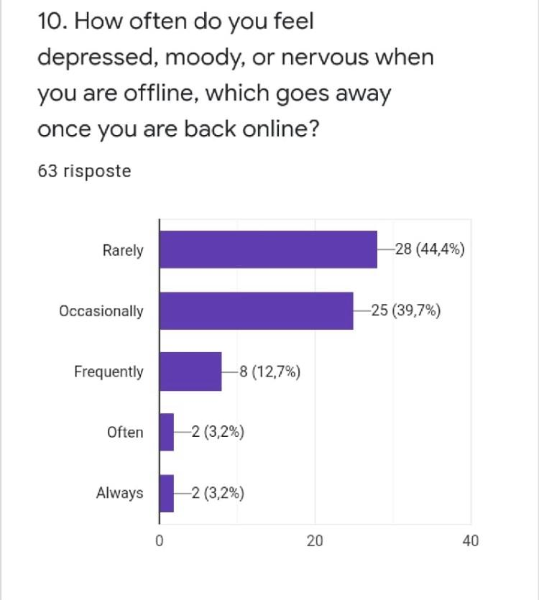
As can be seen from the statistics only 3.2% feel, always or often, depressed or nervous offline while 44% rarely feel so. These are very important data considering the technological age we live in, and it shows that most young people manage to be happy even without the internet and do not depend on social media.

Slide 12
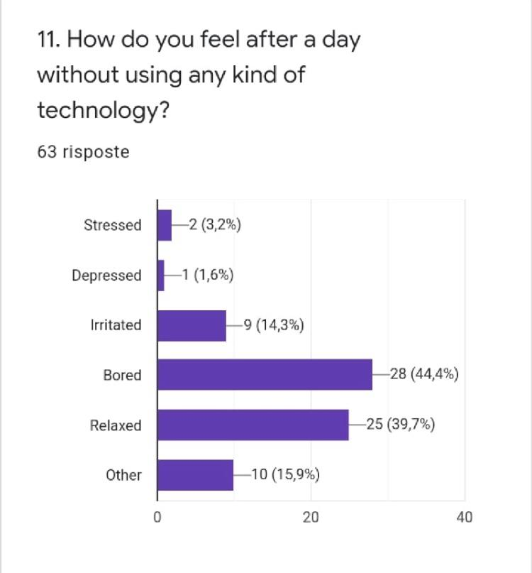
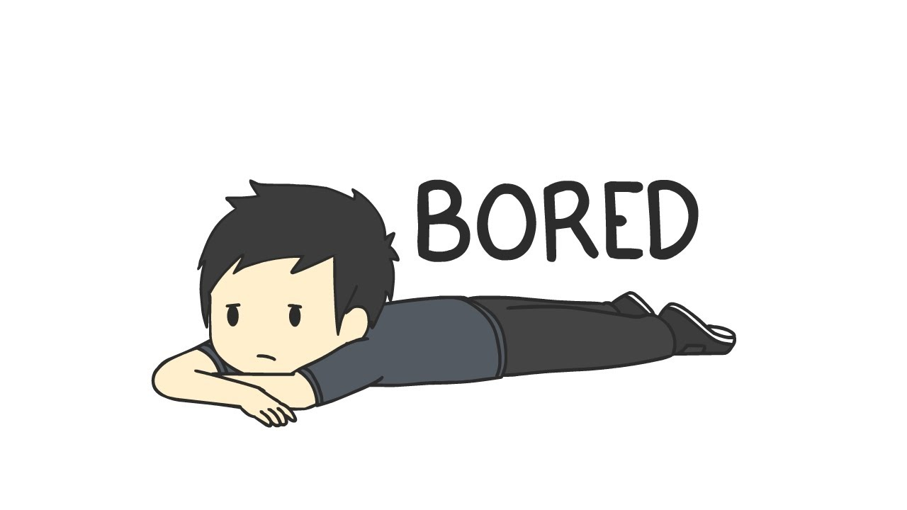
Here the graph shows 44.4% of adolescents, after a day without any type of technology, are bored. This means that it is rare to find someone who has a truly balanced relationship with electronic devices, and with the smartphone in particular. But 39.7% of teens also feel relaxed and this shows that it is perfectly possible to leave the phone for a day and to focus a little on ourselves instead of checking our notifications!

Slide 13
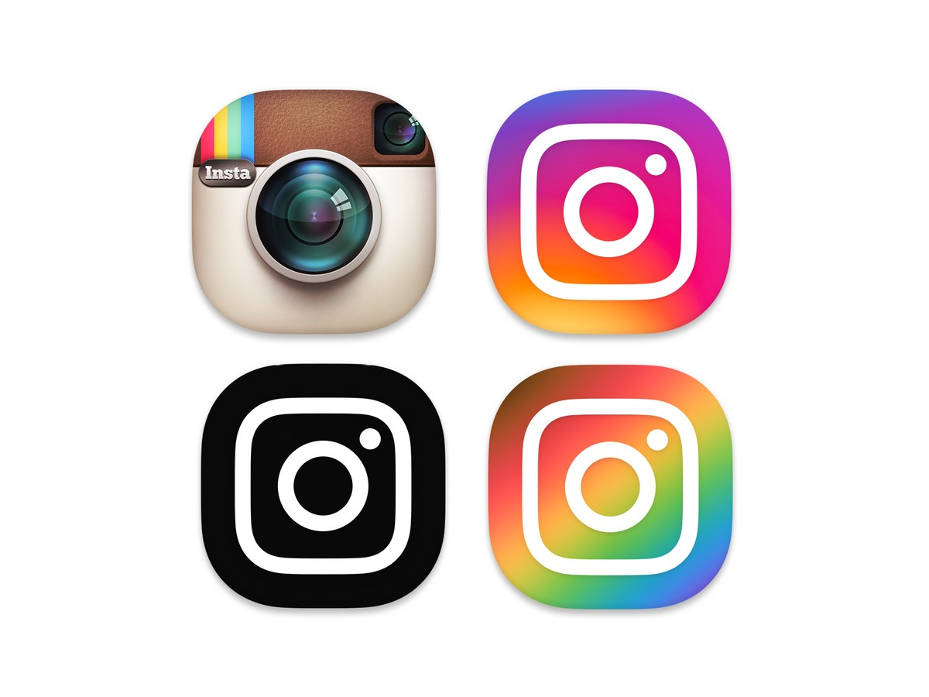
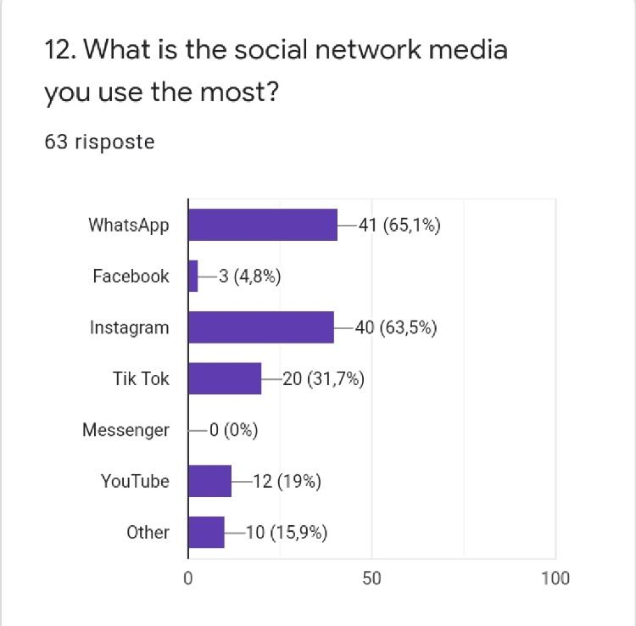
The latest results show the two social media most used: Whatsapp (65,1%) and Instagram (63,5%), while no one use Messenger and only the 4,8% use Facebook. Youtube is used by the 19% and the 15,9% use other social media

Slide 14
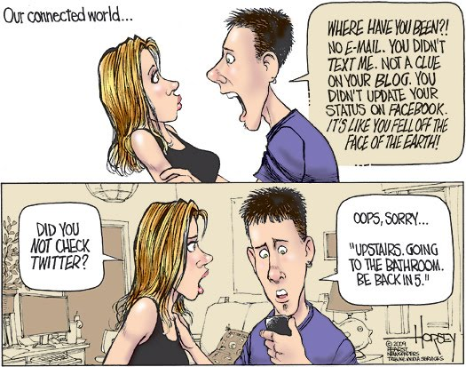
Lost in Cyberspace...
The Internet & Digital Media Technology, such as the Smartphone is a social-ish activity that is simultaneously socially isolating.
Can we connect and be disconnected at the same time?
1. Multitasking can reduce productivity by approximately 40-percent according to some researchers.
2. Switching from one task to another makes it difficult to tune out distractions and can cause mental blocks that can slow down your progress.
3. It multiplies amount of time that it takes to accomplish any one task.
4. Generation-D have false perception of being able to do multiple things at once, but studies have shown that actual comprehension of tasks is reduced by the number of open processing tasks engaged in.

Slide 15
