Slide 1
Polish and foregin politycy on problems and solutions to the smog
By Szymon Mazurek
Erasmus+ 2019

Slide 2
Poland’s politic
Politics in Poland in the current smog does not do enought. There’s the anti-smog program, which involves the replacement of stoves for gas stoves. However we have too little budget to get rid of most of the smog. In addition we are one of the countries in Europe that has the biggest problem with smog. Our government is not doing enought to eliminate this problem and the numer of deaths caused by smog is still increasing.

Slide 3
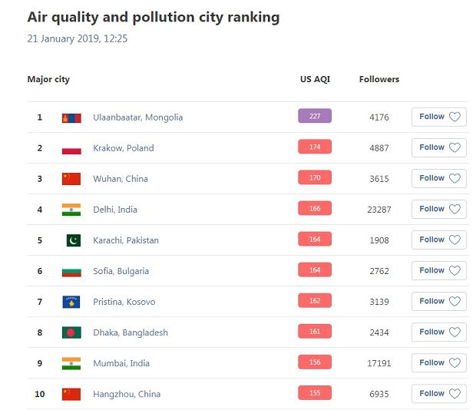

Slide 4
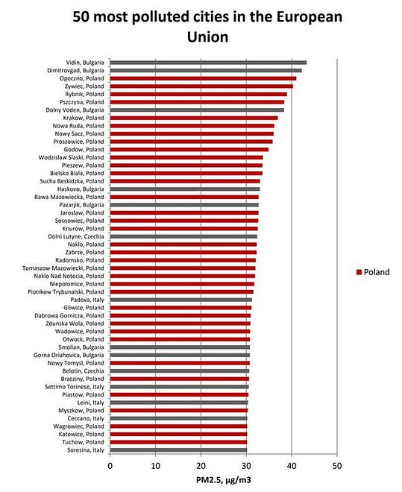

Slide 5
As you can see Poland is very hight situated in the smog ranking which has a very bad impact on our country

Slide 6
European capitals began an unequal fight against smog in the 1950s and 1960s, when in Poland nobody has raised the topic of polluted air yet. Only recently in our country it has become louder and Poles began to invest in anti-smog masks and control air quality using the application.

Slide 7
The next step in the fight against smog should be consistent and systematic fight against the causes of its formation, as is the case in other European countries, where air quality standards are more stringent. The most popular solutions include: 1. No entry for combustion cars into designated areas (includung city centers); 2. Investments in cycling infrastucture and public transport; 3. Restriction of transit traffic; 4. Reduction of coal burning and thermo-modernization of houses and furnances;

Slide 8
What the capitals of other countries are doing about smog?

Slide 9
Ireland, Dublin
In Dublin a total ban on the sale of hard coal was introduced in 1990, thank to which air pollution by harmful particulate matter was reduced by 70 percent. By 2015, 28 Irish cities had been banned according to the same issue. In Poland, such radical solutions have not been introduced, but the sale of coal waste and sludge has already been banned

Slide 10
Englang, London
In London, by 2020 selected streets will become inaccessible to diesel vehicles. Drivers are gradually accustomed to this-currently enrering the center is associated with high fees. Also lory sums (over a thousand zlotys per day) are collected from trucks, vans and buses driving behind London’s gates. The restrictive actions of the authorities significantly reduced the traffic of cars, and thus the emission of toxic compounds and the formation of smog. In 2018, it was reported that for the first time in a decade, nitrogen dioxide levels in the capital of England did not exceed WHO standards

Slide 11
Thanks for your attention I hope you enjoyed it

