Slide 1
Smog
What is done nationally, locally and internationally

Slide 2
How big is the problem
It is estimated that 7,2 millions of people died an early death due to smog
And smog damages the brain.
The big productions are often located in big cities
Air pollution can be looked at on this map: http://aqicn.org/map/europe/

Slide 3
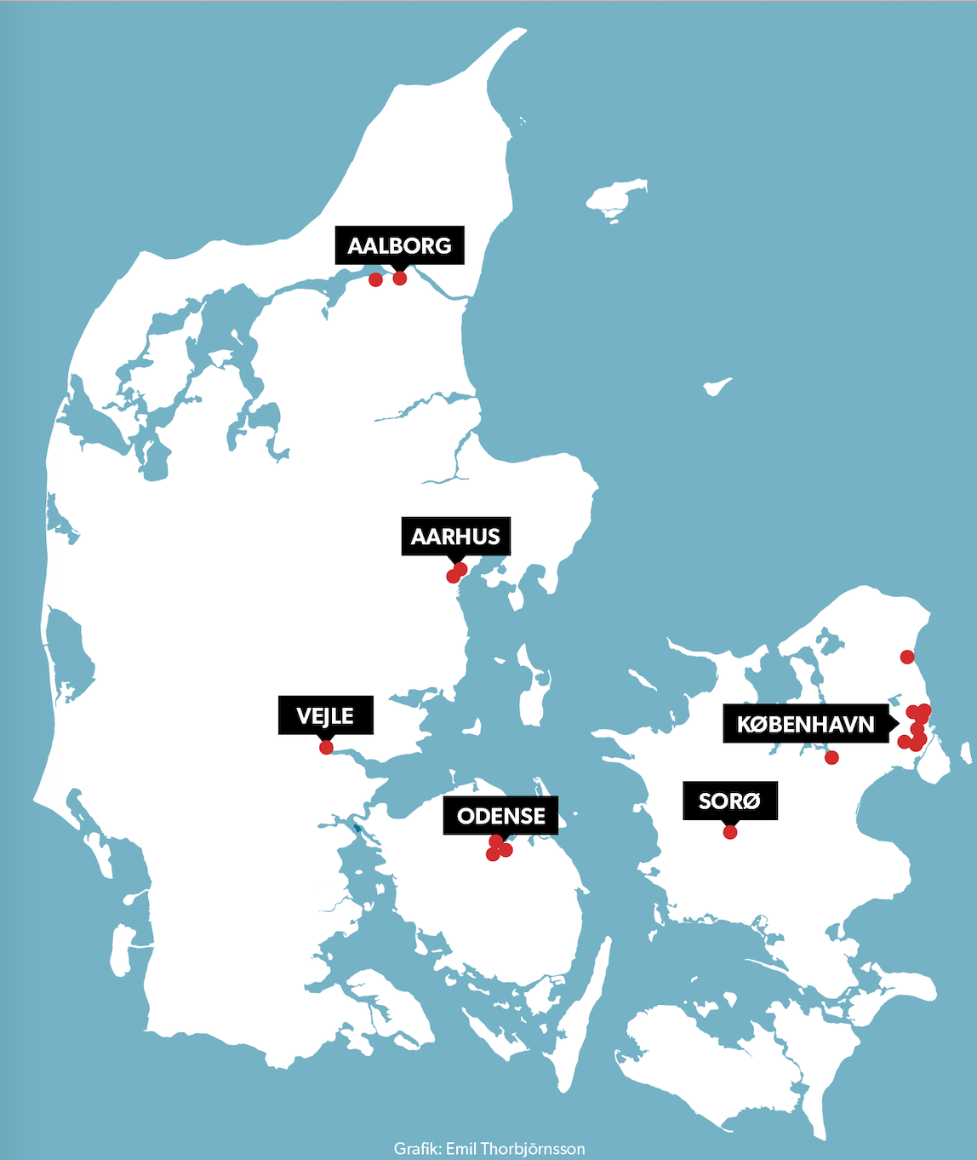
What do we do on national plan?
Aarhus, Odense & Copenhagen
The 3 biggest cities in Denmark
Here they have the biggest problem

Slide 4
Copenhagen
Program of 8 places to improve:
Cleaner working machines
Busses and trains: electric, and a green zone
Ship and tourism: The most difficult one
Stoves: Old apartment
Different Asphalt: To absorb the particles

Slide 5
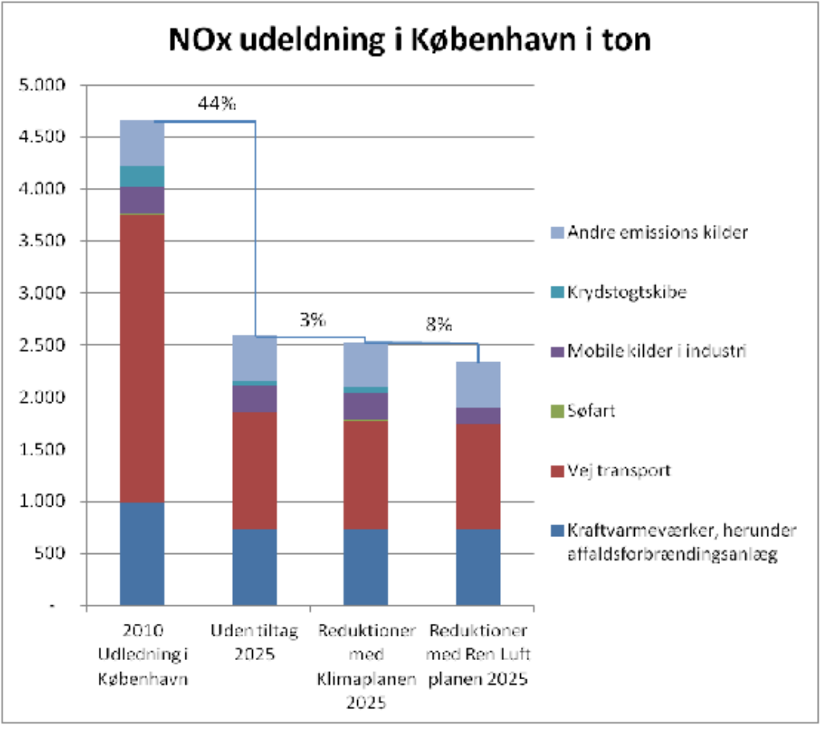
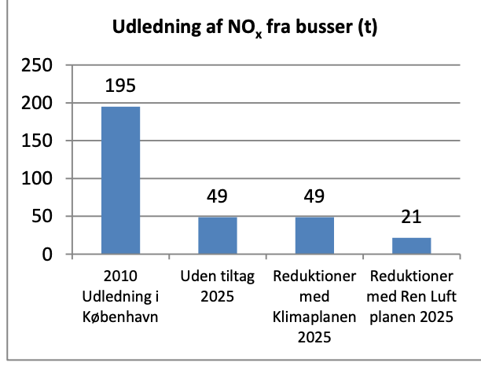
What are the plans in Copenhagen

Slide 6
What happens on international plan?
Denmark have big plans;
Research
Big companies
The law of climate
Eu;
The global goal 7
Laws; they are not kept

Slide 7
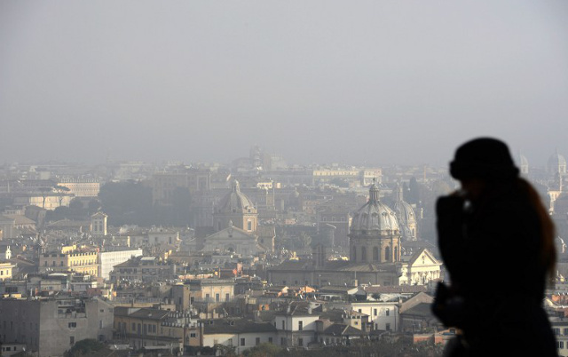
What can the local city do/ what does the local city do
Solutions:
Use green energy:
-Streetlights
- Help the people to use green energy and help them to have a more CO2 free life
What have been done:
Municipality: No law, Windmills and busses

