Slide 1
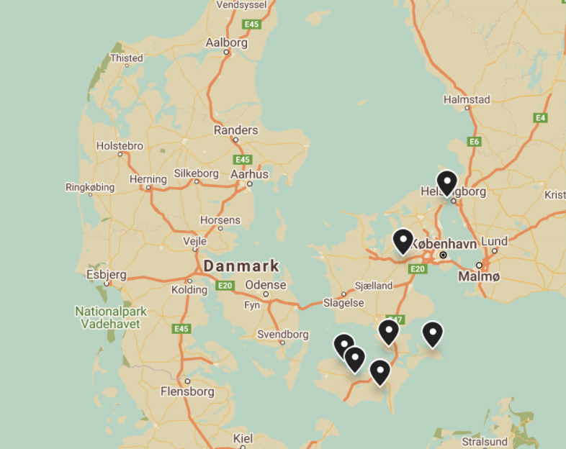
Our school.

Slide 2
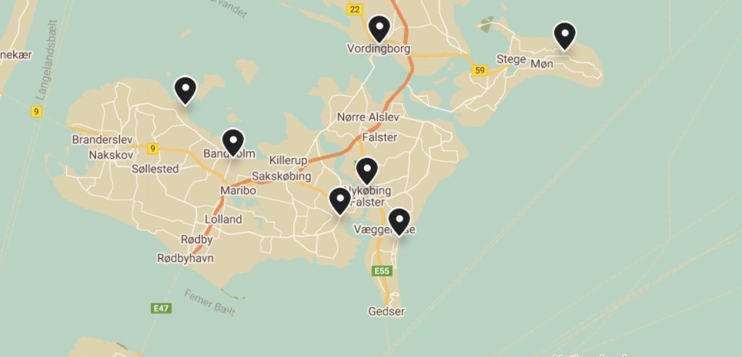
Local area.

Slide 3
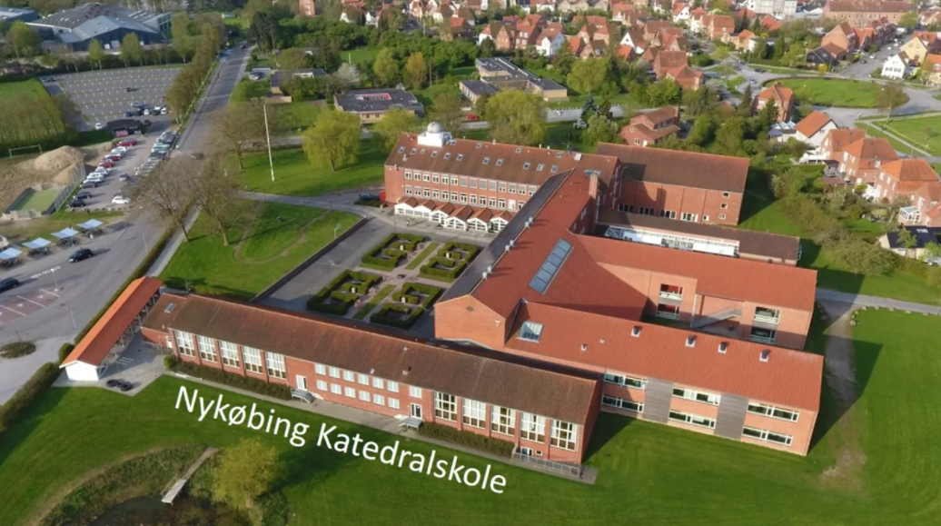
Nykøbing Katedralskole
Beach of Marielyst

Slide 4
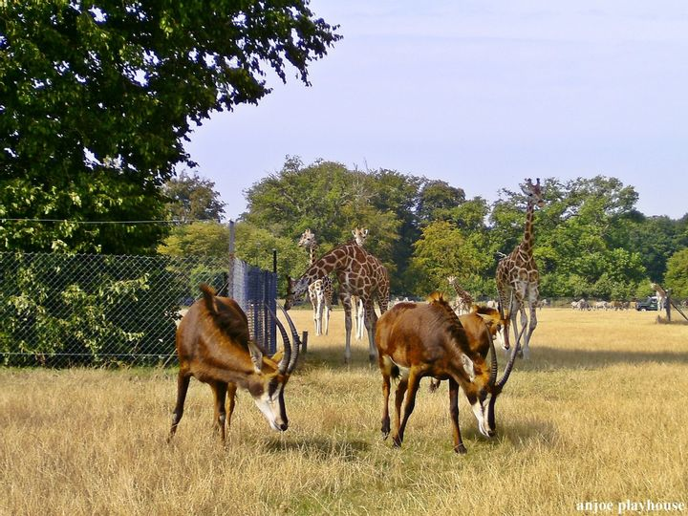
Fuglsang art museum
Knuthenborg Safaripark
Knuthenborg Safaripark is a safarireserve with more than 1000 animals. Knuthenborg has more than 70 species of animals. The animals have large and open areas in the park, that are divided into areas corresponding to their habitats.
Fuglsang Kunstmuseum is one of the oldest art museums in Denmark, comprising a significant collection of Danish art from ca. 1780-1980. The museum always shows a selection of own artworks as well as exhibitions. The award-winning architecture is designed by Tony Fretton and harmonizes with the atmospheric surroundings; the manor house and nature in the beautiful countryside of south-east Denmark.

Slide 5
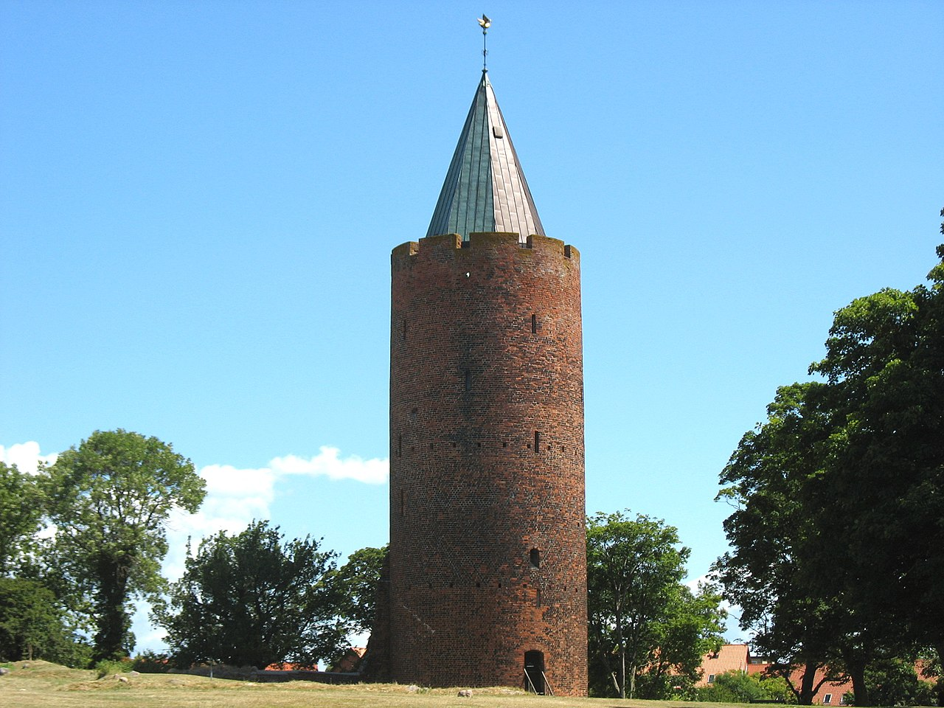
Dodekalit
Vordingborg Castle
The castle was built in 1175 by King Valdemar I of Denmark as a defensive fortress, and as a base from which to launch raids against the German coast. Today Vordingborg Castle is a ruin, although parts of the fourteenth century ring walls remain.
The Dodecalith is a unique and distinctive monument of impressive giant stone sculptures accompanied by music matched to the season. It is a must see, if you go to Denmark.

Slide 6
Møns Klint
Møns Klint is a very popular excursion spot and that is also very understandable. The beautiful white cliff with the height og 128 meter raises over the turquoise blue sea alongside the 7 km stretch of coast. This is very speciel not just for the Danes but also internationally.

